Slide 1





Continuous Integration
Continuous Deployment
The Foundation Of Modern DevOps
Pravin MJ
CI
CD

Slide 2
Session Roadmap
Overview
CI
CD
Integrate
Statistics
Big Picture
Process Requirements
Impact of Digitalization
The Big Picture?
How it has Evolved?
The Future Trend
About
Tools - Open & Paid
Processes & Jobs
Some Statistics
Benefits & Shortcomings
Working Model
So Far..
Delivery
Continuous Deployment
Deployment Strategies
Some Statistics
Benefits & Shortcomings
Working Model
So Far..
Integrations
Observability Platform
Tool chain abyss
Some Statistics
Benefits & Shortcomings
Working Model
So Far..
Survey
What’s done so far
Next Steps
Some Statistics
Benefits & Shortcomings
Working Model
So Far..

Slide 3
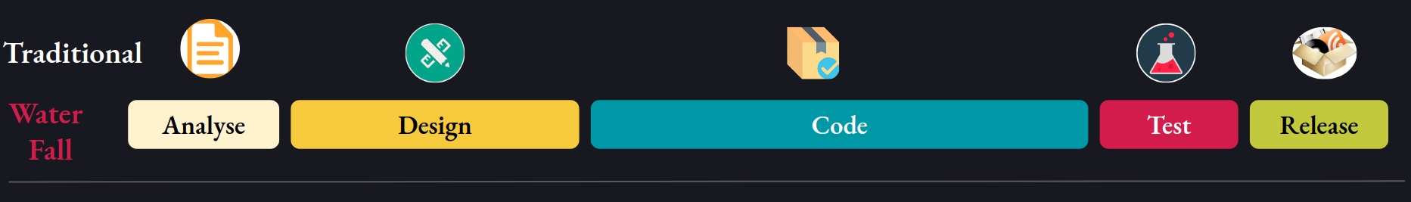
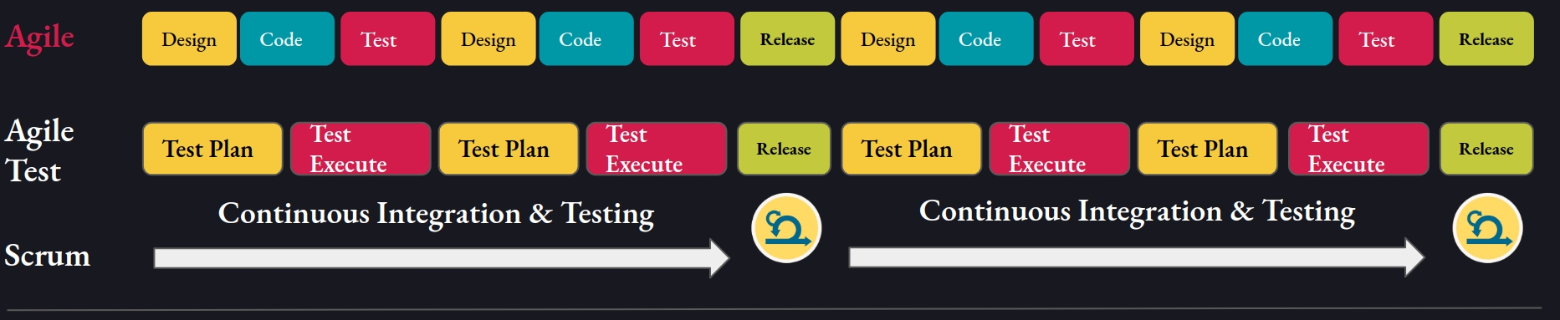
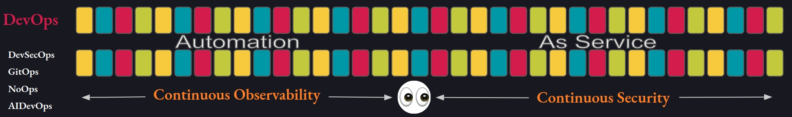
The Path Of Software Enlightenment
Gather & Analyse
Plan & Design
Code

Slide 4
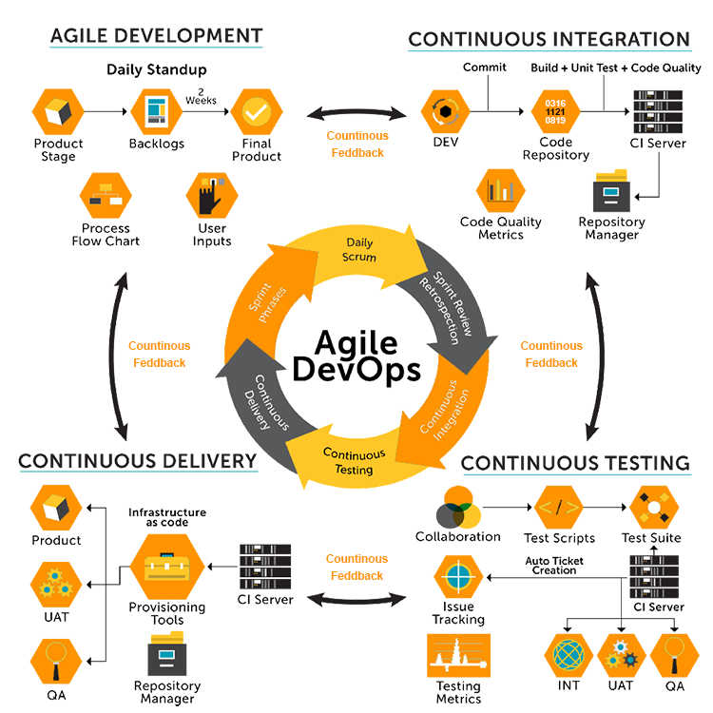
Agile To DevOps
Some Process Methodology in place
BDUF
Choice of best value
JEDI
Cross Role responsibilities
But One POC
REST, GraphQL
Microservices

Slide 5

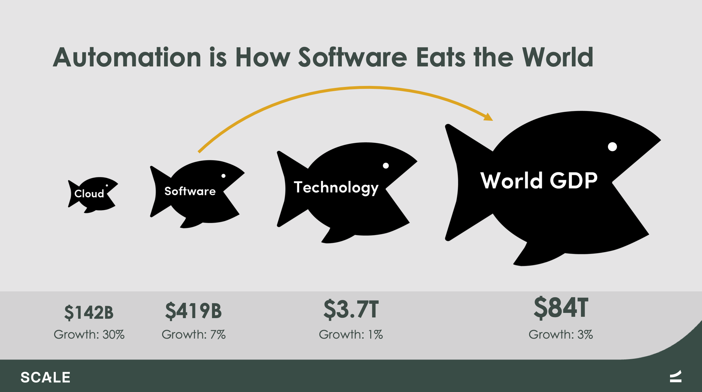
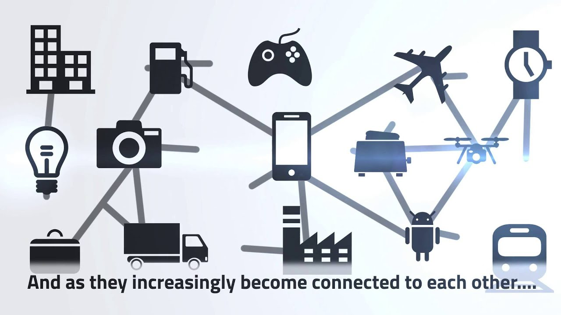
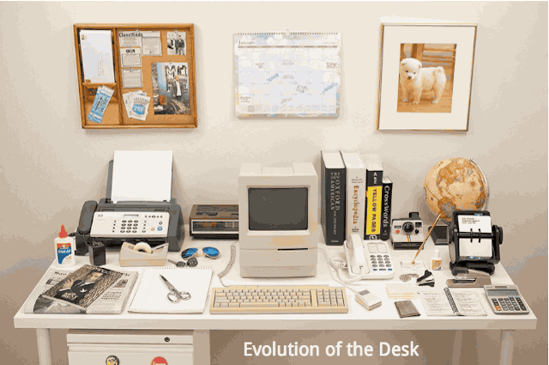
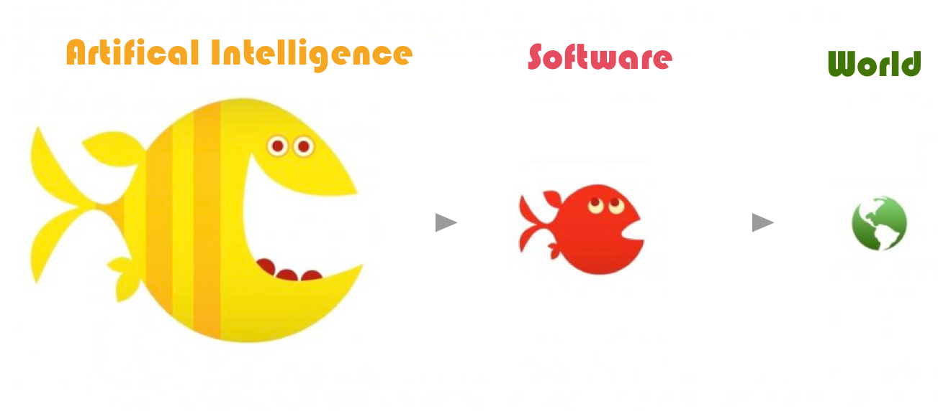
Software Is Eating The World
Everything is a Software
Roles are Evolving
Management gets detailed
Business
Model
Knowledge becomes open-sourced
Maintenance becomes complex
Automation Eats Software
AI Will Eat Automation
Automation
Service / API-First

Slide 6


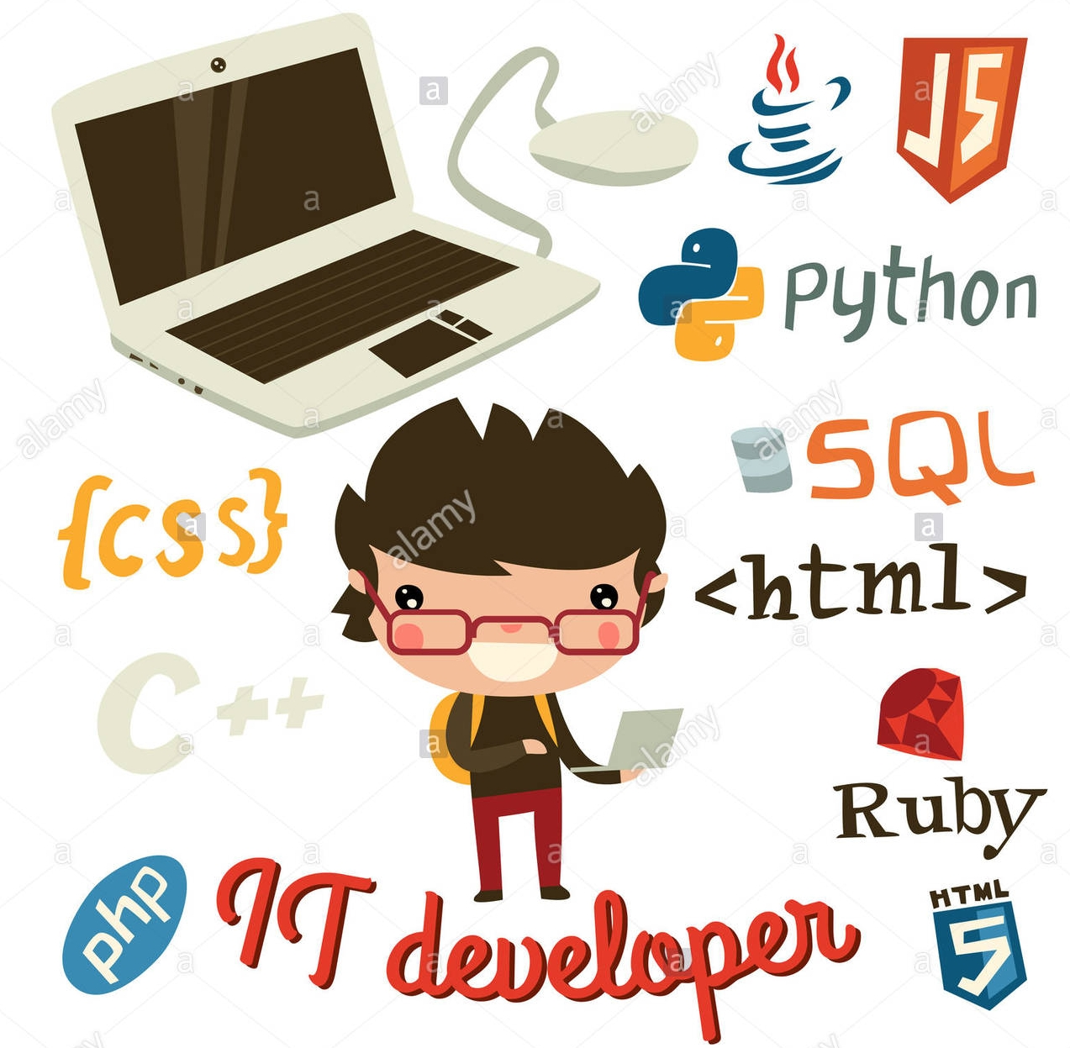










To The Future
Python is in school
Full Stack is No longer
An End to End Tech-Stack
Its an End-To-End Responsibility
YAML is standardized
NoOps Movement
WASM
Developer Responsibilities
Increases
Push For Self Organizing Teams
State Of Constant Conflict Between Teams & Process
Frameworks Comes for the Developer Rescue
Developer Burnout
Tools Comes to Development Rescue
PAAS, SAAS, IAS, MLAS For Business Rescue
Automation & AI
Am I Even Real?

Slide 7







Continuous Integration
Integration of code changes frequently from multiple users to a single project
Using Automation for Code Quality, Builds and Tests before merging to repository

Slide 8



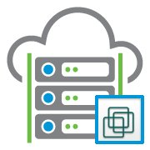
Continuous Integration
Integration of code changes frequently from multiple users to a single project
Using Automation for Code Quality, Builds and Tests before merging to repository
Single Job
Concurrent Job
------------
------------
Config
Agent
Config
Agent
GitLab Runner
GitLab App
Single Agent
Increase as project increases
------------
Parallel Job
------------

Slide 9



Continuous Integration Jobs
Python
Javascript
Code Climate
SonarQube
Flake8
PyFlakes
Flake8
Static Check
PyCodestyle
ESLint/TSLint
McCabe Complexity
Build
Build
Pylint
Test Automation
Mocha
Jest
Jasmine
Puppeteer
UnitTest
PyTest
Django UnitTest
PyTest
API
Security Analysis
Django ~ Deploy Checklist
Bandit ~ Python
SAST/Eslint Security plugin

Slide 10
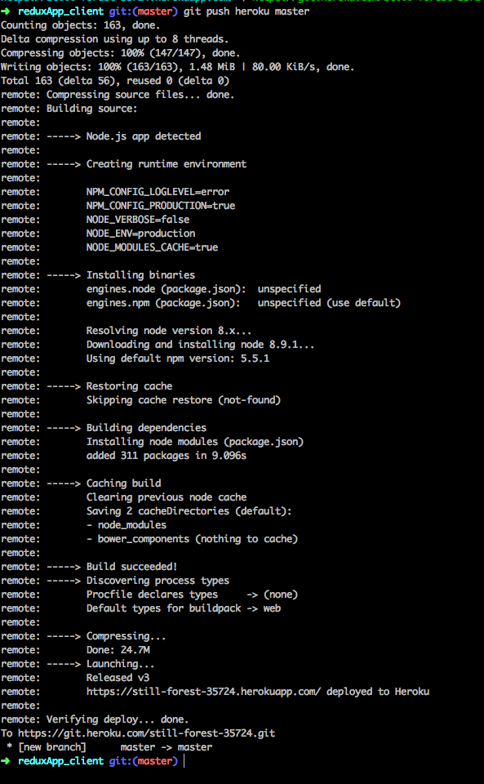
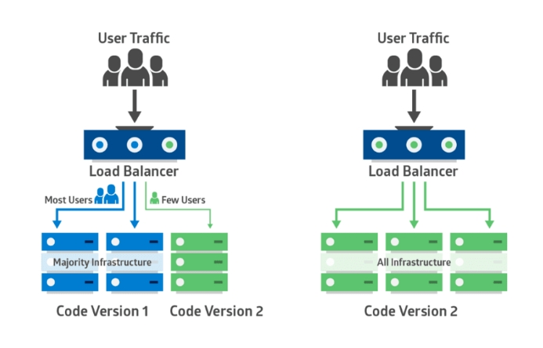
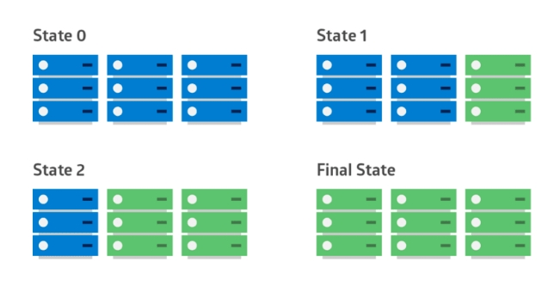
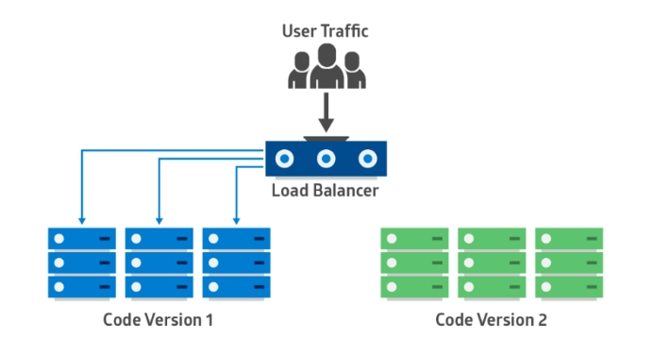
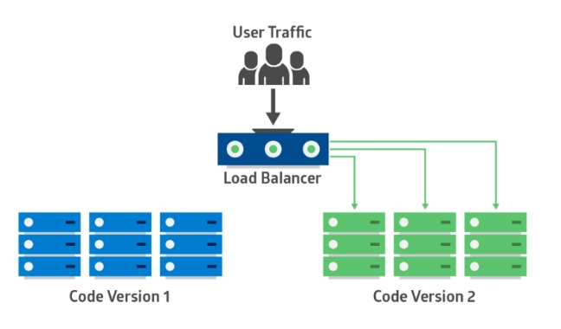
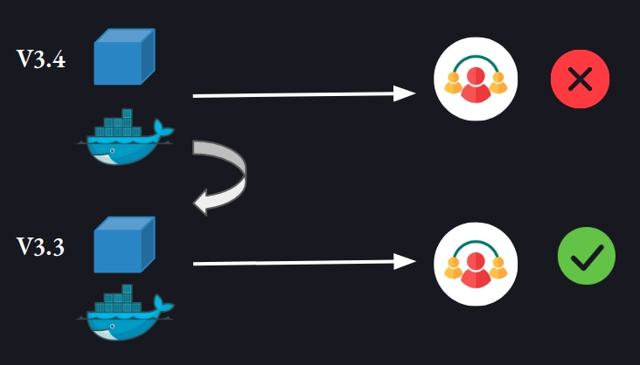


Continuous Delivery
Integrated code changes to an environment (dev, staging, UAT)
Changes are continuously moved to production environment
Continuous Deployment
Target Machine
System Exit Code
------------
Config
Agent
Shell Executor
Configure roll backs to any commits
Heavily Container dependent
Rolling Deployment
Rollback
Blue Green Deployment
Canary Deployment

Slide 11

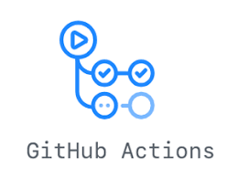



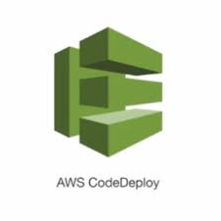

Continuous Delivery
Integrated code changes to an environment (dev, staging, UAT)
Changes are continuously moved to production environment
Continuous Deployment
Target Machine
System Exit Code
------------
Config
Agent
Shell Executor
Alternatives
Configure roll backs to any commits
Containers extends to stateful set
Rolling Deployment
Rollback
Blue Green Deployment
Canary Deployment

Slide 12
GitLab
DevSecOps
Pipeline Minutes or Custom Runner configuration
List of files and directories created by a job
once it finishes
Test Results, Coverage, Monitoring tools, Artifacts,
Package management, Container registry, Kubernetes & Serverless
Completes the Development/operations Lifecycle
Integrates with Open source Tools

Slide 13
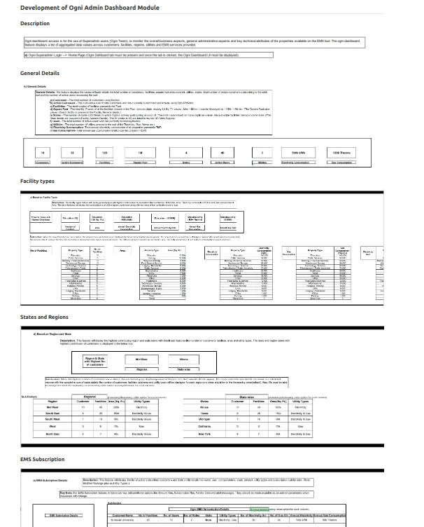
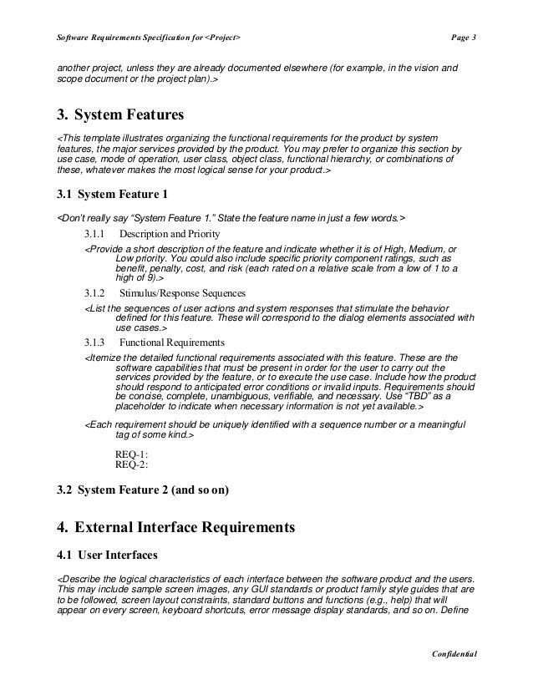
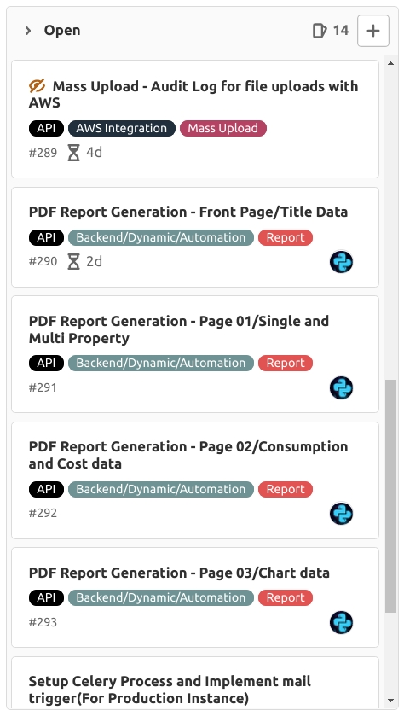
GitLab
DevSecOps
Continuous integration
Deployment
Idea
SRS
Requirements
Document
User Stories

Slide 14
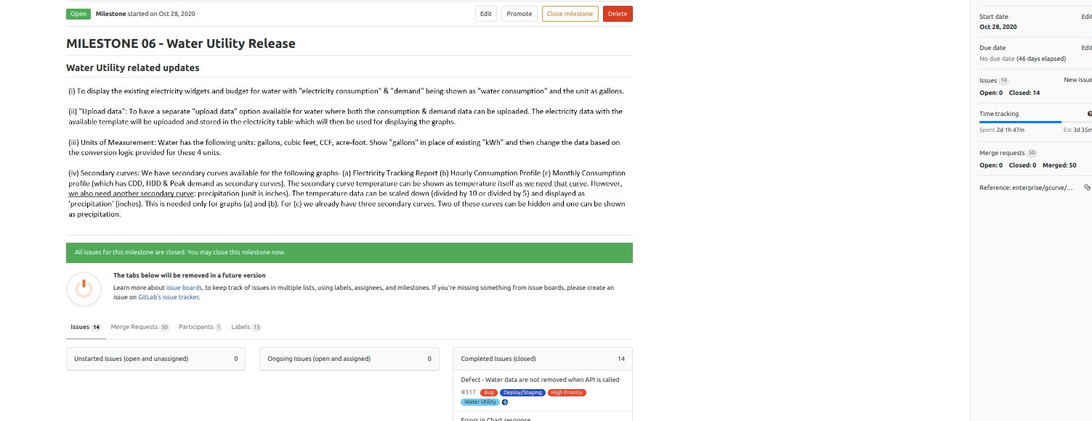
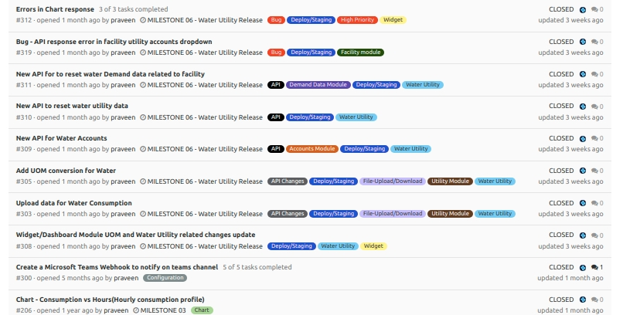

GitLab
DevSecOps
Idea
Continuous integration
Deployment
Plan
Set weight and Priority
Add Milestones
Time Tracking

Slide 15
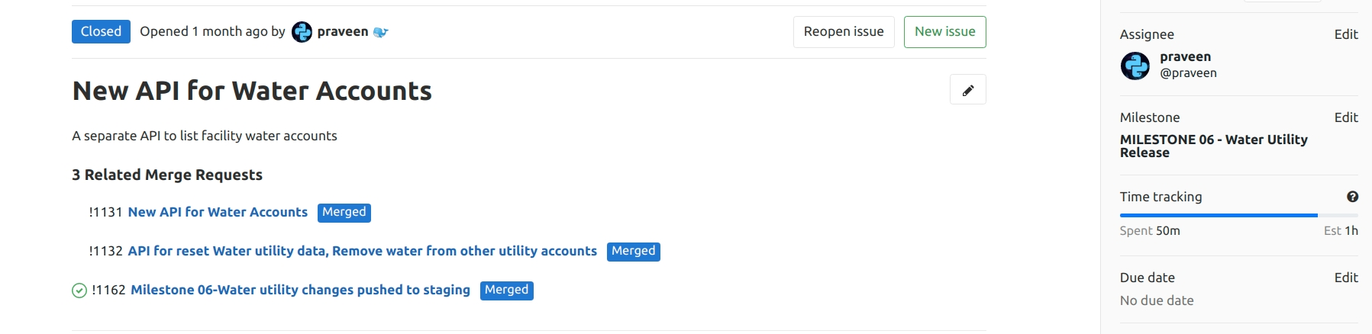
GitLab
DevSecOps
Idea
Plan
Continuous integration
Create
Commit and tag
Branching strategy
Wiki

Slide 16
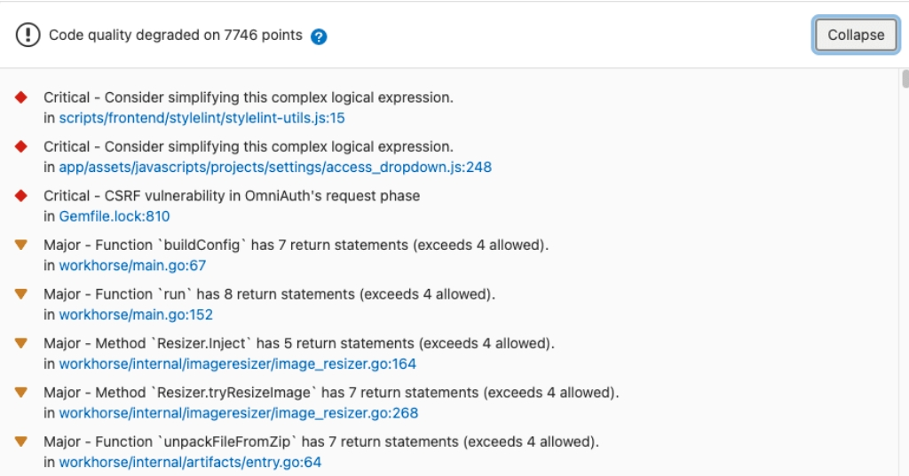
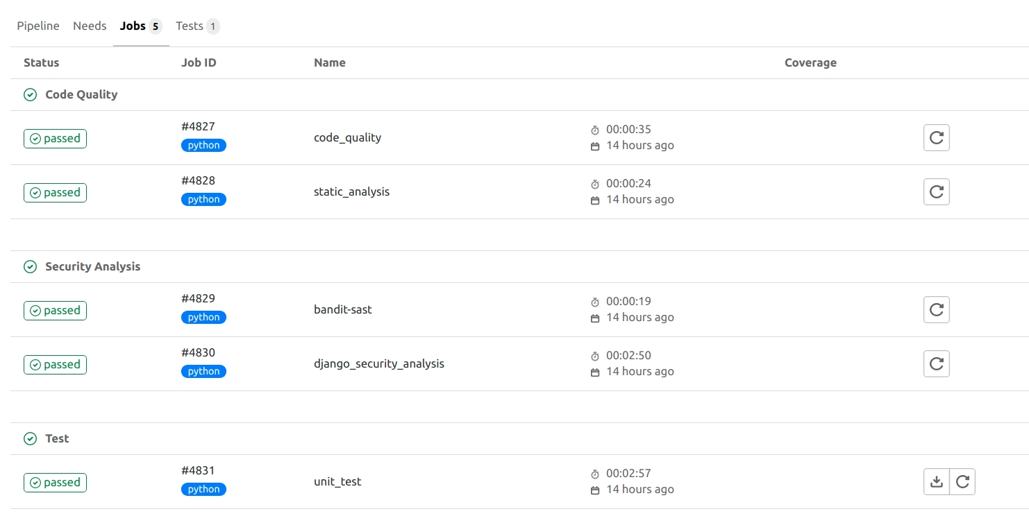
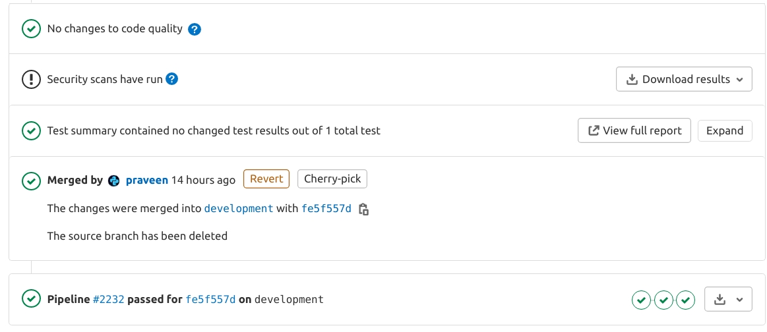
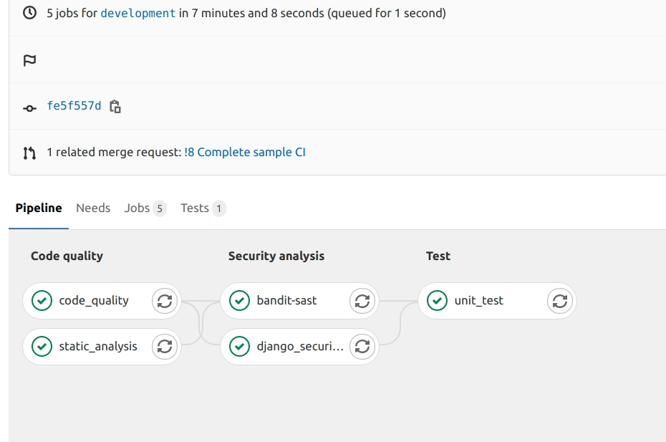
GitLab
DevSecOps
Idea
Plan
Create
Continuous integration
Deployment
Verify
Run jobs before MR
Multiple grouped & parallel jobs
Download Reports, Code Quality Widget

Slide 17
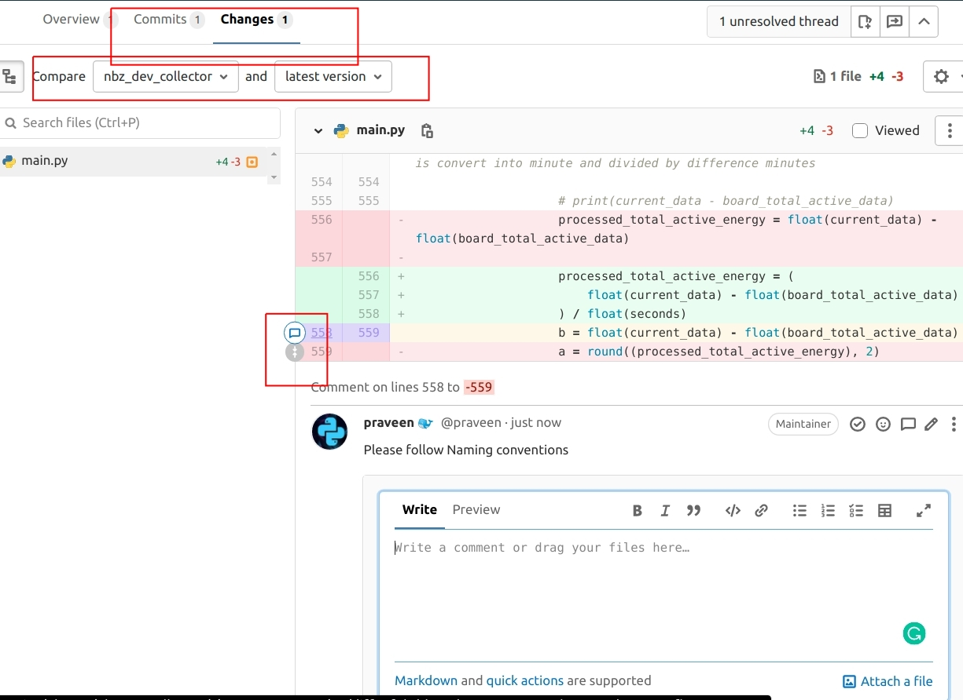
GitLab
DevSecOps
Idea
Plan
Create
Continuous integration
Deployment
Verify
Code Review/Approve/Permissions

Slide 18
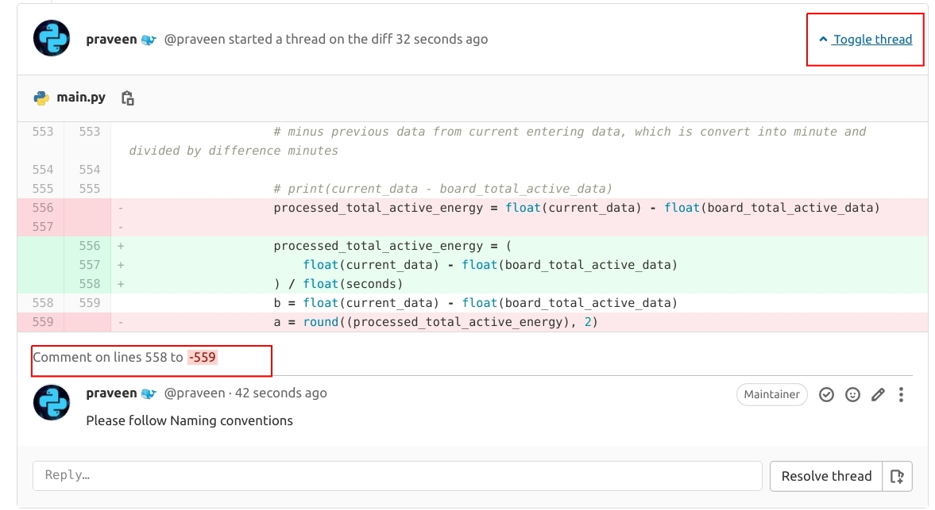
GitLab
DevSecOps
Idea
Plan
Create
Continuous integration
Deployment
Verify
Code Review/Approve/Permissions
Start Discussions and Threads

Slide 19
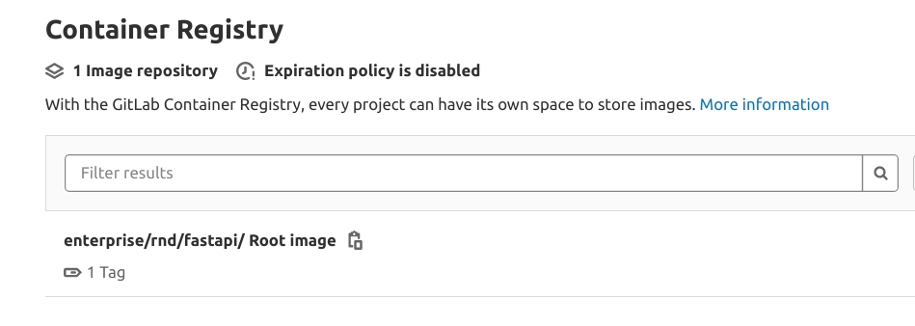
GitLab
DevSecOps
Idea
Plan
Create
Verify
Continuous integration
Deployment
Package
Upload & maintain Container images

Slide 20
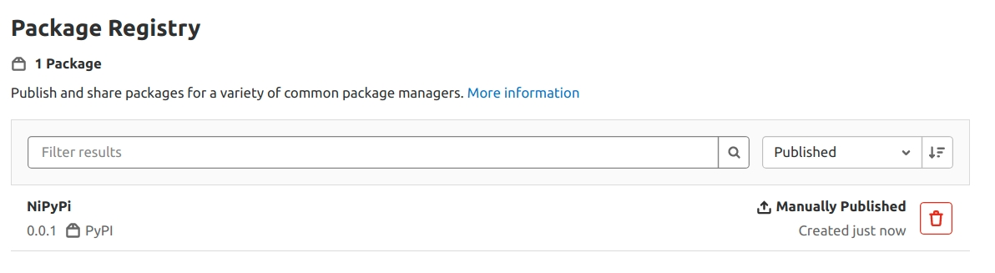
GitLab
DevSecOps
Idea
Plan
Create
Verify
Continuous integration
Deployment
Package
Upload & maintain Container images
Pypy, Npm, Conan, Maven

Slide 21
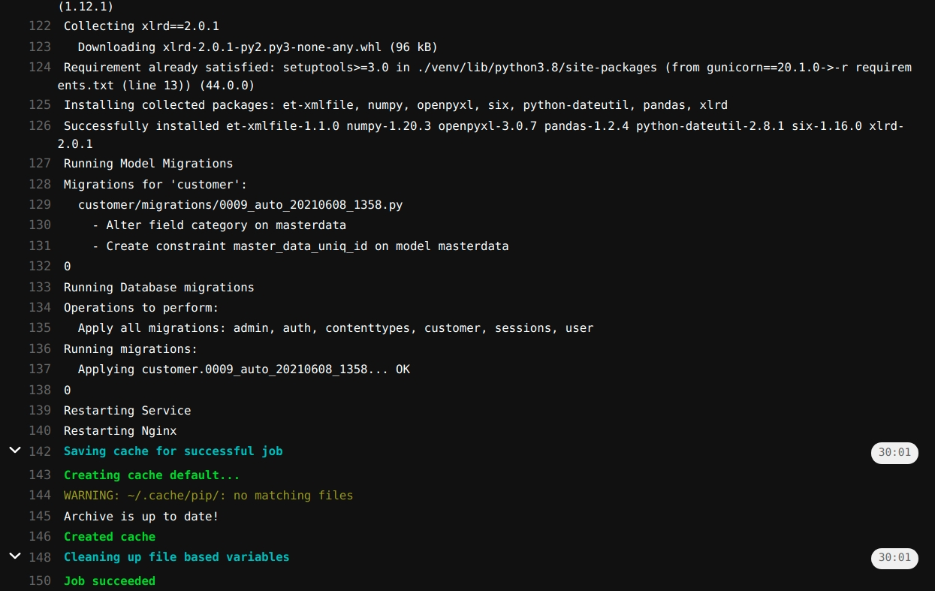
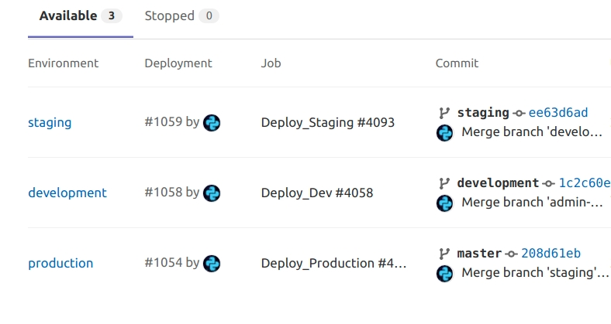
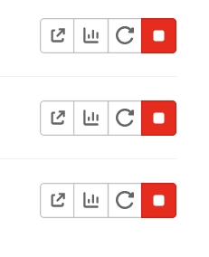
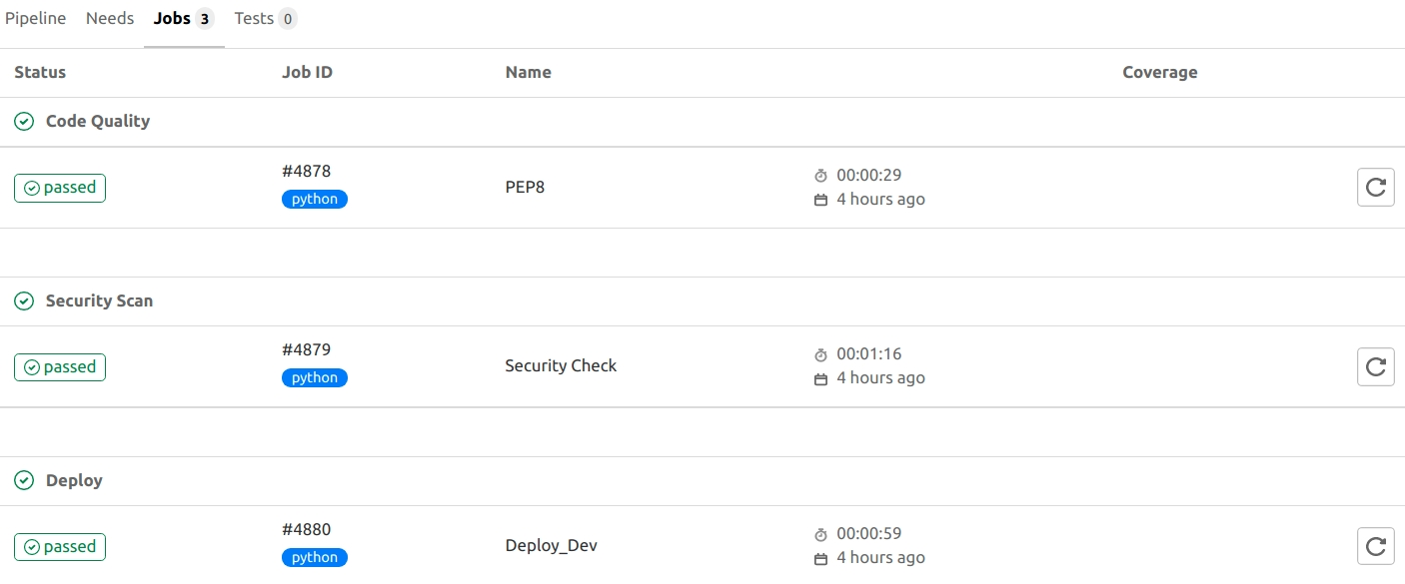
GitLab
DevSecOps
Idea
Plan
Create
Verify
Package
Continuous integration
Deployment
Release
Deploy to environment
View environment and deployments
Web Hooks and Monitoring Integrations

Slide 22
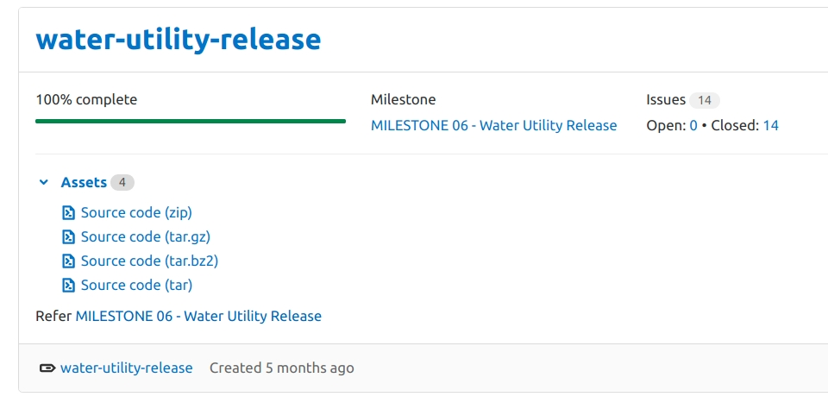
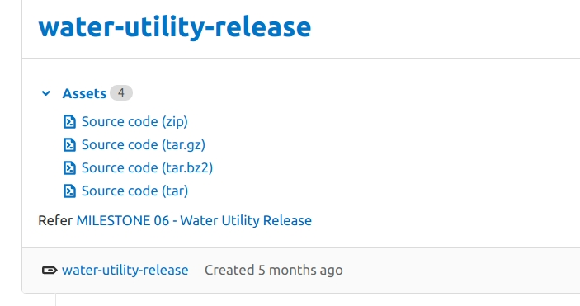
GitLab
DevSecOps
Idea
Plan
Create
Verify
Package
Continuous integration
Deployment
Release
Checkpoint in source code
Snapshot/build artifacts/metadata
Associate Milestones

Slide 23

GitLab
DevSecOps
Idea
Plan
Create
Verify
Package
Release
Continuous Integration &
Deployment
There Is A SDLC Traceability

Slide 24






GitLab
DevSecOps
Idea
Plan
Create
Verify
Package
Release
Continuous Integration &
Deployment
Continuous Observability
There Is A Full Observability

Slide 25
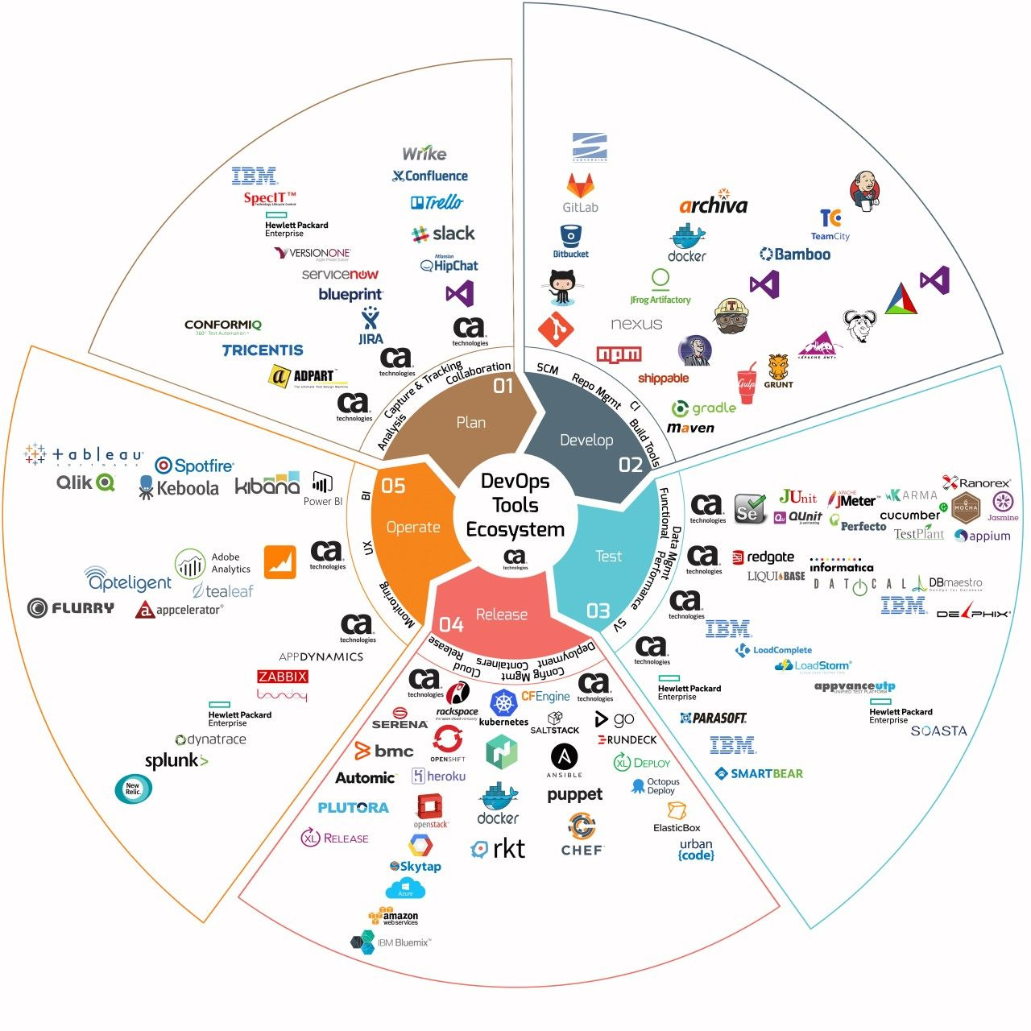

The ToolChain Explosion
Development
Operations
DBA
Networking
Standards & Compliance
Security Specialist
Quality Control
Containers
Cloud Technology
Business Goals
Cross Collaboration

Slide 26

DataOps
DevSecOps
ArchOps
DevOps
AIOps
SRE
MLOps
WinOps
BizOps
TestOps

Slide 27
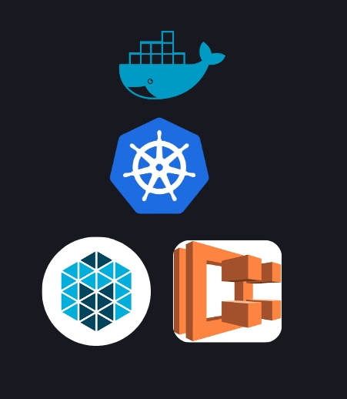
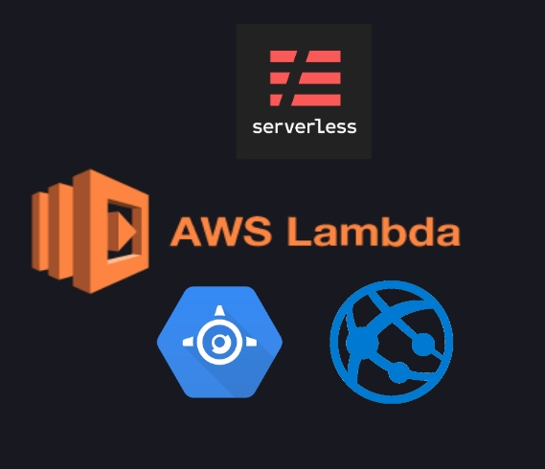
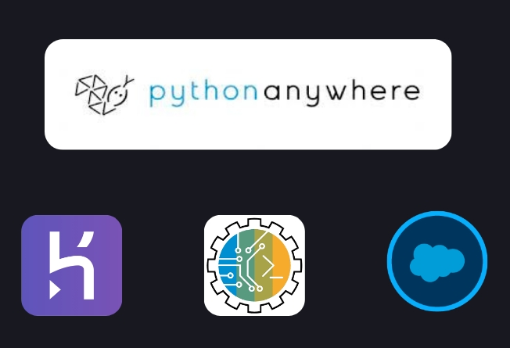
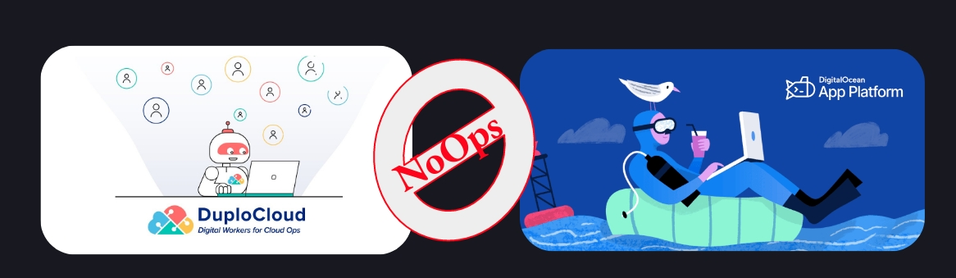
Automation -> DevOps -> NoOps -> AI
What suits us?
Where we are?

Slide 28
Closing Notes
DevOps Survey Results 2021
Only the Key Takeaways

Slide 29


Deliverables
Barriers
61% say it helped them produce high quality deliverables
37% say lack of skills in employees
49% say they see a faster time to market
36% say legacy infrastructure
49% say it improved their deployment frequency
35% Culture and Rigid process
61%
85%
Produce high quality deliverables
Some form of obstacles

Slide 30
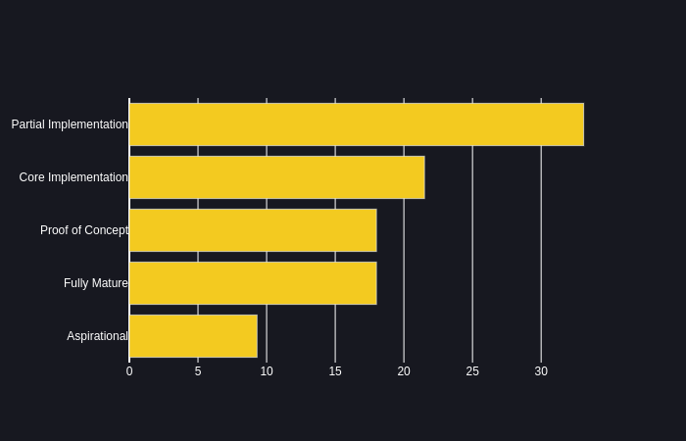
Source code Management and code development are the most widely spread toolchains used
80%
Best describe your teams CI/CD practices
CI
79%
Delivery
76%

Slide 31
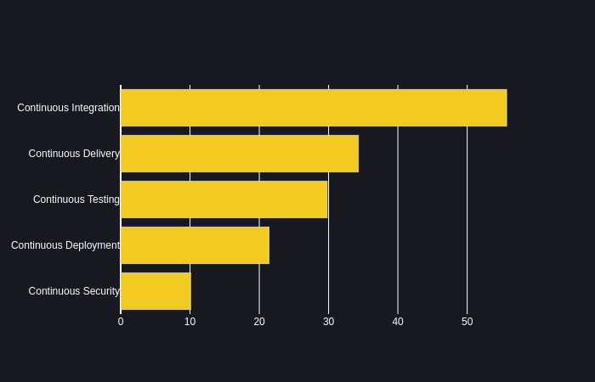
Source code Management and code development are the most widely spread toolchains used
80%
Best practices implemented
CI
79%
Delivery
76%
Soft Skills & Collaboration

Slide 32
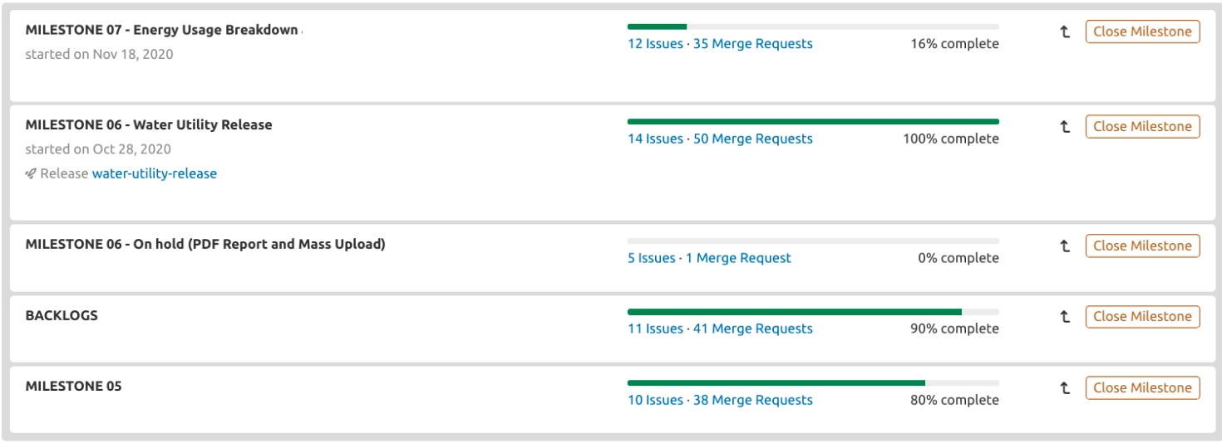
What has been Done So Far
It All started with enman...
7
Milestones

Slide 33
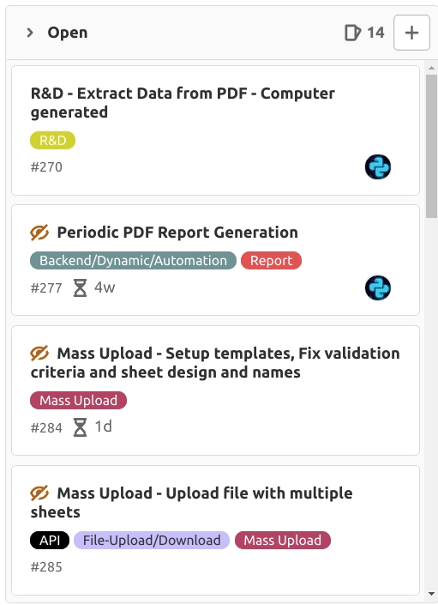
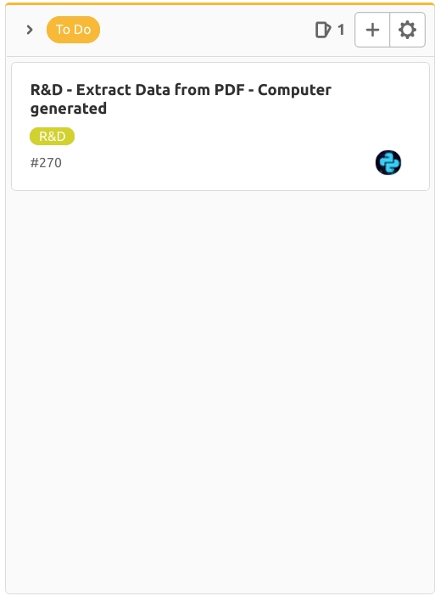
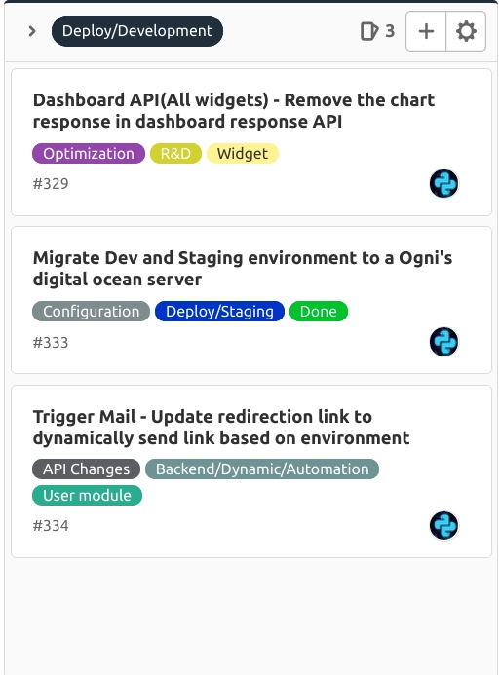
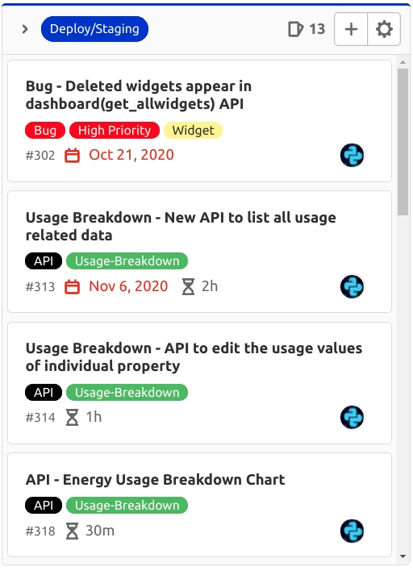



What has been Done So Far
7
Milestones
334
Issues

Slide 34





What has been Done So Far
7
Milestones
334
Issues
1844
Pipelines
880
Dev Deployments
240
UAT Deployments
Related Pipelines
Related Commits
Related Changes
Related Issues
Entire Project Lifecycle Traceability. From An Idea To Value to Delivery

Slide 35

What has been Done So Far
The Power of Wiki
Home Page - TOC
DB Schema Designs and .SQL
API Endpoints
Case Studies
Benchmarking APIs

Slide 36




What has been Done So Far
The Power of Wiki
CAN
MicroScheduler GraphQL
Docker Stack
PDF Designs

Slide 37


What has been Done So Far
Design Management
CAN
MicroScheduler GraphQL
Docker Stack
PDF Designs
Manage Designs
Discussions

Slide 38



What has been Done So Far
Pipelines Configured for Microscheduler, Smart-meter, CAN, Portal, 5G, MLOps. Started for Frontend
OpenAPI Swagger Spec
Private PIP Packages
Container Registry

Slide 39


What has been Done So Far
Metrics Visibility
Prometheus-Grafana Observability Platform
Environment and Monitoring Config

Slide 40



What has been Done So Far
Sentry Integration
Sentry Error tracking
Performance Monitoring
Project Related Errors
Create Issues from Erros

Slide 41



What has been Done So Far
ChatOps
Webhooks Integration
Python - MSTeams
Smart-meter stats
Smart-meter critical alerts

Slide 42

Next Steps...
Consistent SDLC in Place
Continuous Delivery & Continuous Deployment
Better Code Review/ Peer Review
Design Management
Better Release Management
Next Session On Grafana...
Improve the Centralized Observability Stack
Kubernetes/Serverless/Microservices

Slide 43
Thank You
Its Q&A
Breathe In...
Breathe Out...

